Slide 1
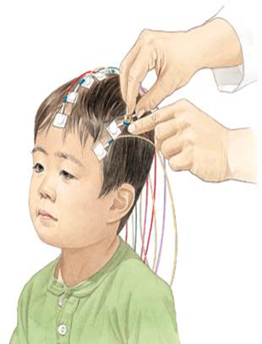
Midterm Presentation Estimating Brain Activation Patterns from EEG Data
Student: Gal Maman
Supervisor: Or Yair
Semester: Winter, 2017
Date: 20/12/2017
In Collaboration with: Dr. Danny Eitan

Slide 2
Outline
Medical Background
Project Goal
Block Diagram - Review Blocks
Results
Conclusion
Future Work

Slide 3
Medical Background
Acute brain injury is a common cause for hospitalization in pediatric and adult intensive care units with traumatic brain injury being the leading cause of death in children and young adults.
Problem: Routine brain imaging with modalities such as MRI or Computed Tomography (CT) are not always feasible. Even when MRI is performed, it is usually in the later stages of the illness.
Need: A system that can be applied at the bedside of critically-ill patients and provide functional mapping and neuromonitoring.

Slide 4
Medical Background
Solution: EEG monitoring
Electroencephalography (EEG) is a method to record electrical activity of the brain.
Measures voltage fluctuations resulting from ionic current within the neurons of the brain.
Noninvasive, with the electrodes placed along the scalp.

Slide 5
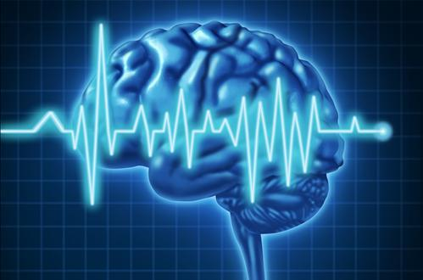
Project Goal
Provide a system that uses EEG signals to early detect the neurological injury, aid in guiding therapy and improve outcomes.

Slide 6
Literature Survey
Describe existing solutions for the problem that you’ve found in the literature survey
For each solution, give a general description, some details, pros and cons (quality, complexity, cost, …)

Slide 7
Block Diagram
Raw Data
Preprocessing
Statistical features extraction
Features processing
Classification
Classified Data

Slide 8
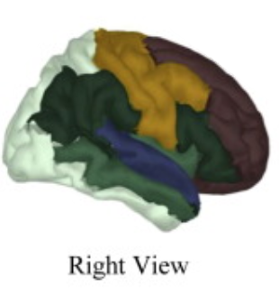
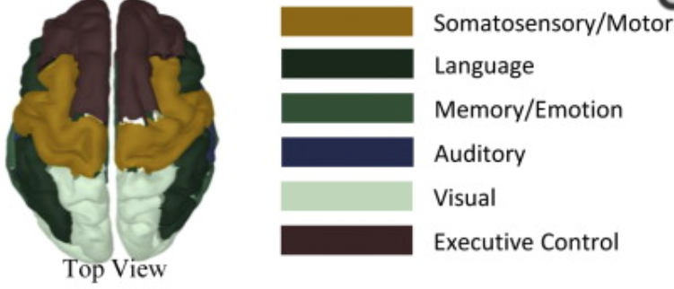
Our Raw Data
Eleven healthy volunteers ranged in age from 7 to 16 years (median 12 years).
Five critically-ill patients ranged in age from 2.5 to 16 years (median 8.5 years); all with acute brain injury of various etiologies. In these patients, all recordings were done in the critical care unit while subjects were in the acute phase of their illness (less than one week of admission to hospital).
The stretchable electrode cap contained 68 EEG electrodes, The set-up consisted of three multi-modal sensory stimulation generators: visual, auditory and somatosensory.
The final data includes 200-1000 trials for each stimulation (9 stimulations) from every subject (16 subjects).

Slide 9
Block Diagram
Raw Data
Preprocessing
Statistical features extraction
Features processing
Classification
Classified Data

Slide 10
PreProcessing
The preprocessing was performed by Gilad and Ronen in the previous project and included these steps for each trial:
Convolution with BPF.
Cutting the signal in time so the length will be 0.5 msec.
Down sampling from 5kHz to 1kHz.
Disqualify trials (short-time windows) and electrodes; An electrode will be classified as bad electrode if more than 5% of her trials for a certain stimulation per subject will be announced as bad. In this case all of the electrode trials will be deleted. Otherwise, only the specific bad trials will be deleted. At the end of the cleaning process we remained with 32 electrodes.

Slide 11
Block Diagram
Raw Data
Preprocessing
Statistical features extraction
Features processing
Classification
Classified Data

Slide 12
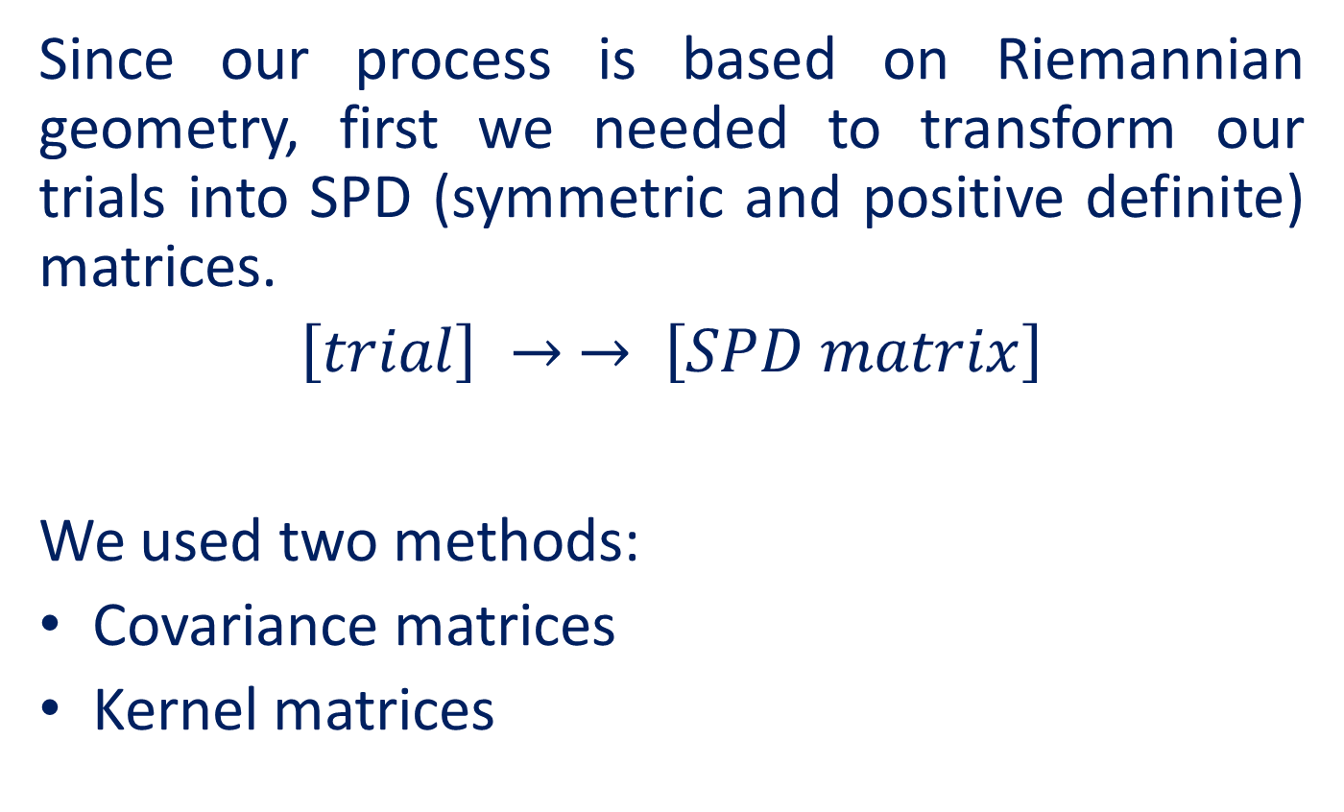
Statistical Features Extraction
Since our process is based on Riemannian geometry, first we needed to transform our trials into SPD (symmetric and positive definite) matrices.
$\left[trial\right] → → \left[SPD matrix\right]$
We used two methods:
Covariance matrices
Kernel matrices
32 X 500
32 X 32

Slide 13
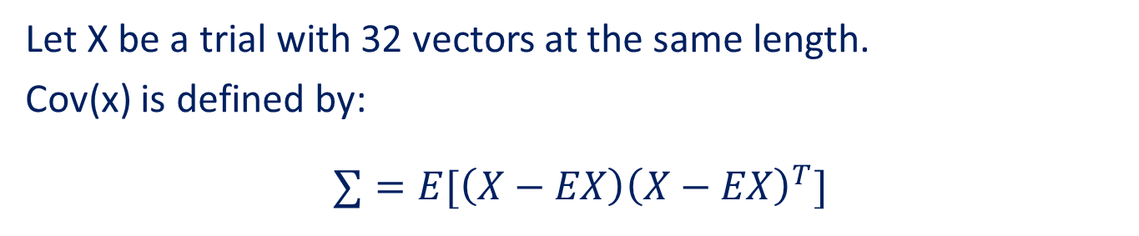

Covariance Matrices
Let X be a trial with 32 vectors at the same length.
Cov(x) is defined by:
$∑=E[\left(X−EX\right){\left(X−EX\right)}^{T}]$
Kernel Matrices
We chose to use the Gaussian kernel:
A kernel matrix for trial X is defined by:
$$K\left(x_{i}, x_{j}\right)=exp(\frac{−{\left\|x_{i}−x_{j}\right\|}^{2}}{ε})$$

Slide 14
Block Diagram
Raw Data
Preprocessing
Statistical features extraction
Features processing
Classification
Classified Data

Slide 15
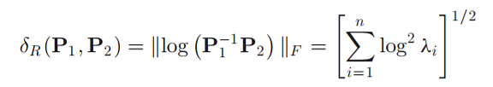
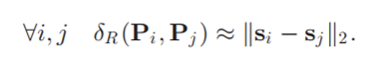
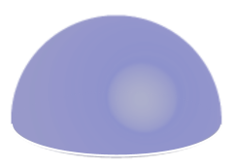
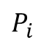
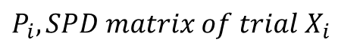
Riemannian Geometry
The space of SPD matrices p(n) is a differentiable Riemannian Manifold ʍ.
The Riemannian Geodesic Distance is defined by:
In order to use popular classification algorithms we first need to project our matrices into an Euclidean tangent space.
Then we will use the approximation:
$$P_{i}$$
$$P_{i}, SPD matrix of trial X_{i}$$
ʍ

Slide 16
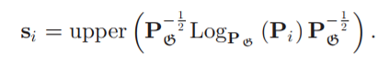
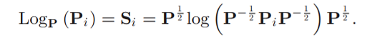
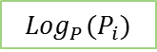

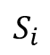
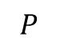
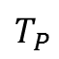
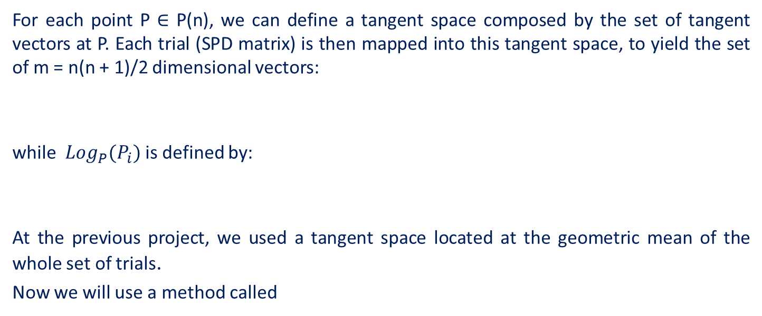
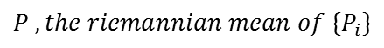
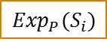
For each point P ∈ P(n), we can define a tangent space composed by the set of tangent vectors at P. Each trial (SPD matrix) is then mapped into this tangent space, to yield the set of m = n(n + 1)/2 dimensional vectors:
while ${Log}_{P}(P_{i})$ is defined by:
At the previous project, we used a tangent space located at the geometric mean of the whole set of trials.
Now we will use a method called
Parallel Transport.
$$P , the riemannian mean of \{P_{i}\}$$
$${Log}_{P}(P_{i})$$
$$T_{P}$$
$$S_{i}$$
$$P$$
$${Exp}_{P}(S_{i})$$
$$P_{i}$$
$$P_{i}$$
$$P_{i}, SPD matrix of trial X_{i}$$
ʍ

Slide 17
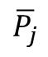
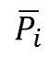
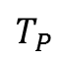
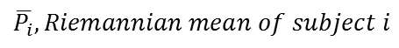
Schild’s Ladder (Parallel Transport)
At this approach, first we will calculate the Riemannian mean for each subject.
Then we calculate regular mean over all Riemannian means.
Then, using parallel transport, we will locate all SPD matrices (which present our trials) around our chosen mean, in a way that will preserve the original structure, by using Riemannian matric properties.
After transferring all of the trials, we will project them on a tangent space located at our chosen mean, just as in the standard method.
$$T_{P}$$
$$\overline{P_{i}}$$
$$\overline{P_{j}}$$
$$\overline{P_{i}},Riemannian mean of subject i$$
ʍ

Slide 18
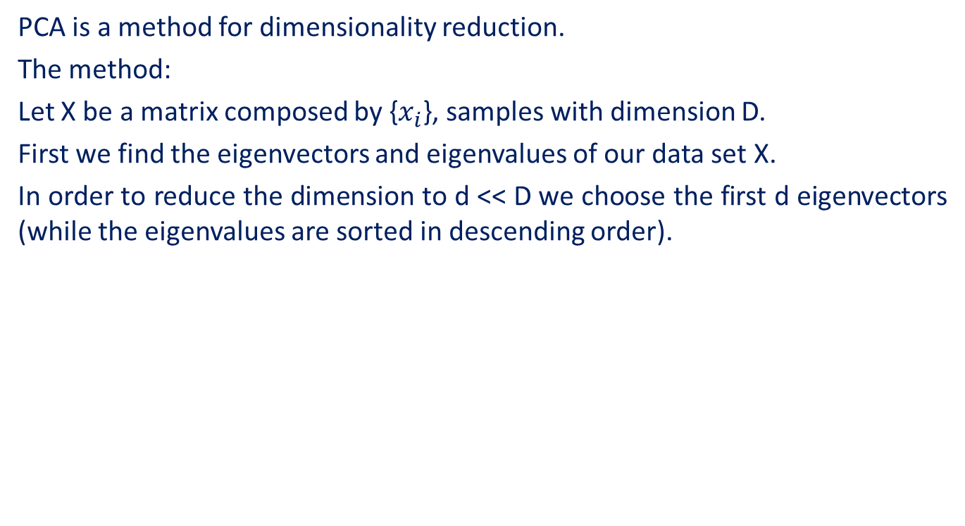
PCA (Principal Component Analysis)
PCA is a method for dimensionality reduction.
The method:
Let X be a matrix composed by {$x_{i}$}, samples with dimension D.
First we find the eigenvectors and eigenvalues of our data set X.
In order to reduce the dimension to d << D we choose the first d eigenvectors (while the eigenvalues are sorted in descending order).

Slide 19
Block Diagram
Raw Data
Preprocessing
Statistical features extraction
Features processing
Classification
Classified Data

Slide 20
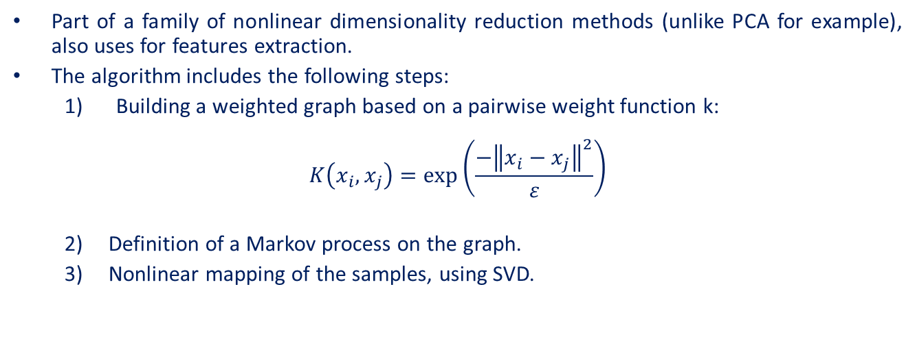
Diffusion Maps by Coifman and Lafon
Part of a family of nonlinear dimensionality reduction methods (unlike PCA for example), also uses for features extraction.
The algorithm includes the following steps:
Building a weighted graph based on a pairwise weight function k:
$$K\left(x_{i}, x_{j}\right)=exp\left(\frac{−{\left\|x_{i}−x_{j}\right\|}^{2}}{ε}\right)$$
Definition of a Markov process on the graph.
Nonlinear mapping of the samples, using SVD.

Slide 21
t-SNE t-distributed stochastic neighbor embedding
This is also a nonlinear dimensionality reduction methods.
t-SNE is mostly suited for the visualization of high-dimensional datasets, i.e. reduction to two or three dimensions.

Slide 22
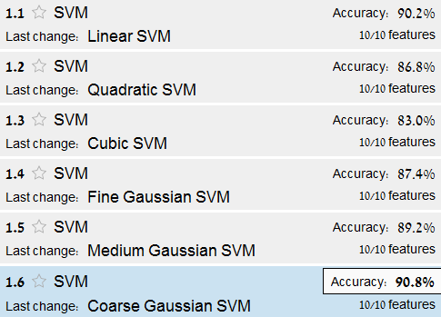
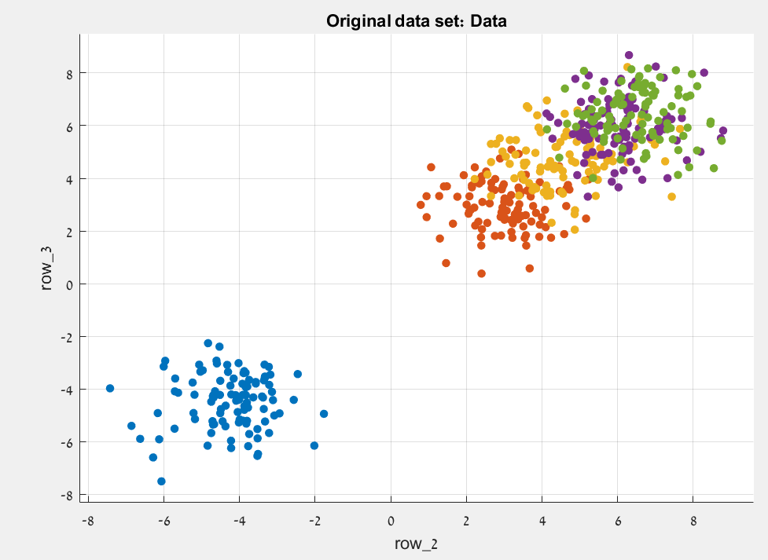
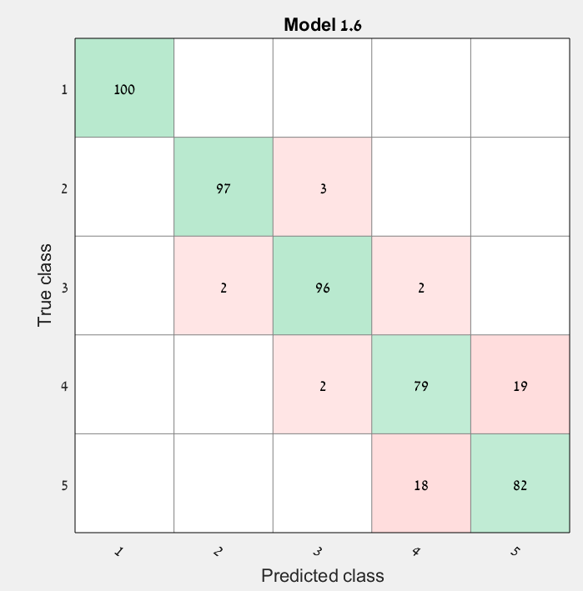
SVM Support Vector Machines
A method used for classification and regression analyses.
SVM represent the data set as points in space, mapped so that samples with different labels are divided by a clear. New samples are then mapped into that same space and ascribed to a label based on which side of the gap they fell.

Slide 23
Block Diagram
Raw Data
Preprocessing
Statistical features extraction
Features processing
Classification
Classified Data

Slide 24
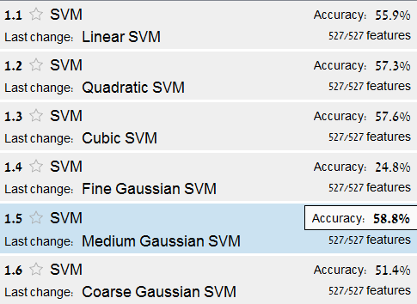
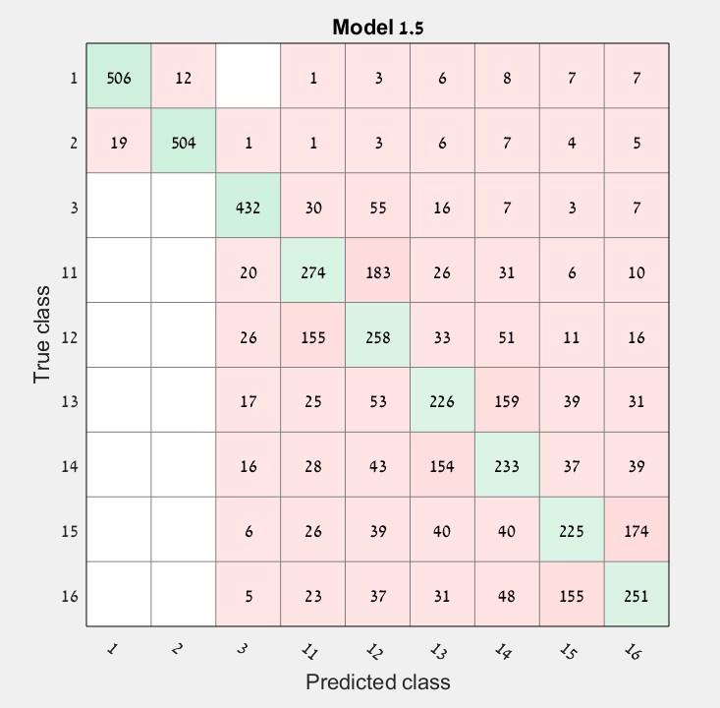
Results Confusion Matrix
Data used: 50 trials from each stimulation, from all healthy subjects (After PCA)
Code | system | details
1 | Somatosensory | right arm
2 | Somatosensory | left arm
3 | Visual | light flash
11 | Auditory | Frequent tone
12 | Auditory | rare tone
13 | Auditory | sham word 1
14 | Auditory | Subject own name
15 | Auditory | sham word
16 | Auditory | Sham word

Slide 25
PCA – all healthy subjects, per subject:
Before PT
After PT

Slide 26
PCA – all healthy subjects, per stimulation:
We can see that while without PT, subject 11 is apart from the other subjects, after PT all the subjects are aligned, and we can see separation by stimulations. Note that all the mixed stimulations are with similar character (visual, auditory and somatosensory).
Before PT
After PT

Slide 27
A series of tests performed on subjects S05, S08 stimulation 1, 3, 16
PCA per subject and stimulation
Before PT
After PT

Slide 28
A series of tests performed on subjects S05, S08 stimulation 1, 3, 16
PCA per subject and stimulation
Before PT
After PT

Slide 29
A series of tests performed on subjects S05, S08 stimulation 1, 3, 16
t-SNE after diffusion maps, per stimulation
using covariance matrices
Before PT
After PT

Slide 30
A series of tests performed on subjects S05, S08 stimulation 1, 3, 16
t-SNE after diffusion maps, per stimulation
using Gaussian kernek matrices
Before PT
After PT

Slide 31
A series of tests performed on 4 healthy and 4 sick subjects stimulation 02,14
PCA per health condition
Before PT
After PT

Slide 32
A series of tests performed on 4 healthy and 4 sick subjects stimulation 02,14
PCA per stimulation
Before PT
After PT

Slide 33
Conclusion
Repeat the project goal in other words
Have you achieved the goal? (if not, this is ok and you have to explain why)
Summarize your results
Emphasize original contribution

Slide 34
Future Work
Suggestions for continuation of your work

Slide 35
References
TALMON, R; et al.‪ Diffusion Maps for Signal Processing: A Deeper Look at Manifold-Learning Techniques Based on Kernels and Graphs.‪ IEEE Signal Processing Magazine.‪ 30, 4, 75, July 2013.‪ ISSN: 10535888.‪‬‬‬‬‬‬‬‬‬‬‬‬‬‬‬‬‬‬‬‬‬‬‬‬‬‬‬‬‬‬
Alexandre Barachant ; et al. Multiclass Brain–Computer Interface Classification by Riemannian Geometry.‪ IEEE Transactions on Biomedical Engineering, Biomedical Engineering, IEEE Transactions on, IEEE Trans. Biomed. Eng.‪ USA, 4, 920, 2012.‪ ISSN: 1558-2531.‪‬‬‬‬‬‬‬‬‬‬‬‬‬‬‬‬‬‬‬‬‬‬‬‬

